Slide 1
CHANGE MANAGEMENT-III
ITIL CHANGE MANAGEMENT BEST PRACTICES
http://www.bmc.com/guides/itil-change-management.html

Slide 2
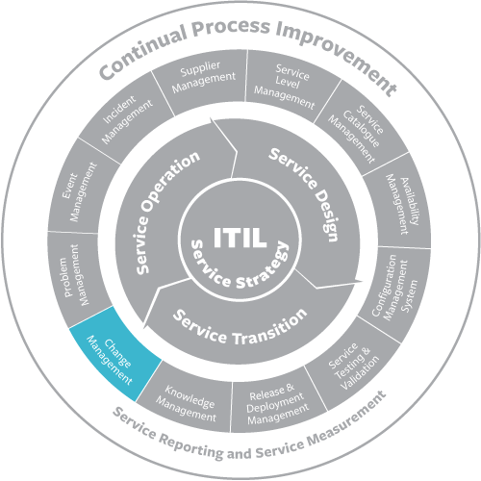
CHANGE MANAGEMENT-III

Slide 3
CHANGE MANAGEMENT-III
CHANGE MANAGEMENT ROLES
The change initiator recognizes and identifies the need for change.
The initiator should be someone who works directly with support services tools.

Slide 4
CHANGE MANAGEMENT-III
CHANGE MANAGEMENT ROLES
Members of your team who provide support services to customers may be best suited for this position due to their frequent interaction with the system.

Slide 5
CHANGE MANAGEMENT-III
CHANGE MANAGEMENT ROLES
The change coordinator assesses requests for change that originate from incident management, problem management, release management, or continuity management.

Slide 6
CHANGE MANAGEMENT-III
CHANGE MANAGEMENT ROLES
The change coordinator registers changes as needed to handle requests for change or receives change requests from other change initiators; determines the risk and impact for requested changes;

Slide 7
CHANGE MANAGEMENT-III
CHANGE MANAGEMENT ROLES
prepares implementation plans by creating tasks; and monitors the progress of changes.

Slide 8
CHANGE MANAGEMENT-III
CHANGE MANAGEMENT ROLES
The change manager is generally needed in mid-sized and larger organizations. If your IT department is part of a larger company, you will need to pick one or multiple persons to perform the role of change manager.

Slide 9
CHANGE MANAGEMENT-III
CHANGE MANAGEMENT ROLES
These individuals are responsible for managing change procedures, receiving and prioritizing change requests, evaluating the risk level associated with requests, and keeping thorough records of the outcome of each change.

Slide 10
CHANGE MANAGEMENT-III
CHANGE MANAGEMENT ROLES
The change advisory board is responsible for authorizing changes and further evaluating requests when the change manager determines that there is a high risk associated with these requests.

Slide 11
CHANGE MANAGEMENT-III
CHANGE MANAGEMENT ROLES
The board takes into account the impact that a requested change may have on all affected parties.
When these high-risk changes are brought to the attention of the change advisory board, the board will …

Slide 12
CHANGE MANAGEMENT-III
CHANGE MANAGEMENT ROLES
…schedule a meeting with a detailed agenda to determine how to proceed.

Slide 13
CHANGE MANAGEMENT-III
CHANGE MANAGEMENT ROLES
The approver decides whether to approve or reject changes.

Slide 14
CHANGE MANAGEMENT-III
CHANGE MANAGEMENT ROLES
The change implementation team consists of the specialists on your team who are responsible for actually making changes.

Slide 15
CHANGE MANAGEMENT-III
CHANGE MANAGEMENT ROLES
You will likely be part of this team and employees directly under you may also be assigned to implement changes.
As an IT manager, you will often be responsible for overseeing changes.
END

